Slide 1
New Features
7.7.59-7.7.68

Slide 2

Katy Patrick
Technical Writer, Keystone Systems

Slide 3
Overview
KLAS Client Updates
Catalog & Equipment
Patron
Duplication
What’s Next?

Slide 4
KLAS Client
Nightly Processing optimizations
Nightly is now scheduled in Batch Manager
30 min “grace period” for Batch Manager jobs to finish before shutdown
Scheduled jobs skipped during a shutdown will run at startup
Notes:
Tldr; Maintenance and Upgrades now much less likely to interfere with scheduled Batch Manager jobs (such as reports, queue refill, dup order creation, etc), now including Nightly

Slide 5
Nightly Configuration
Customize which Nightly Programs are used for each ServeType. Possible examples:
  OnDemand (Dup) – Reserve, Series
  Nightly List Only – Reserve, Series, Request, Author
Customize Program settings & options by PatronType
  IN / Nursing Homes – more Author selections, no HH check, more Subject Exclusion checks
  PI / Incarcerated Patron – no Subject selections, Subject Exclusion checks on everything
Notes:
(*Reserve and Series programs affect Duplication only)

Slide 6
Catalog
Merge Headings can now run in Batch Manager
Catalog Find tool now handling diacritics appropriately
Add/Remove Headings bug fixed (again)

Slide 7
Catalog
Bug fixes for dropped headings
  New titles with multiple headings added before save
  Older records on MARC update
Heading Selection tool updated
  Keyword filter
  Additional information displayed
  Relator field for Authors and Narrators

Slide 8
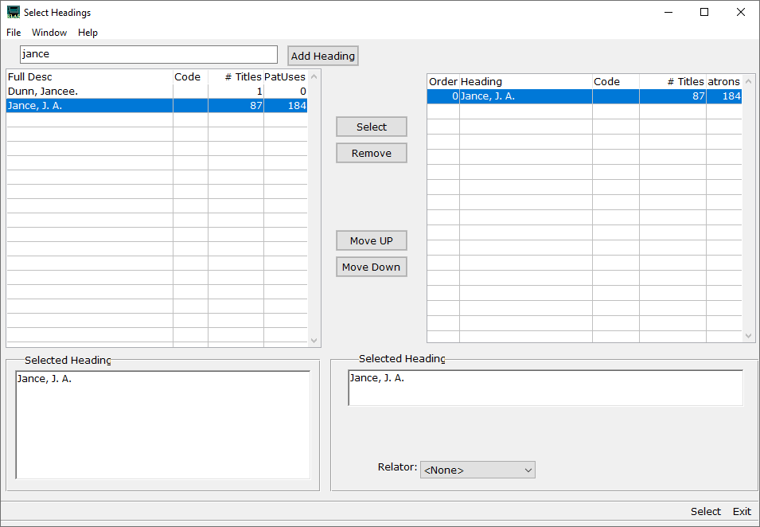

Slide 9
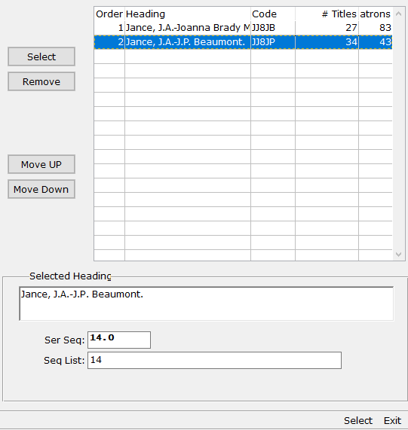
Catalog - Series
Decimal seq order support
Multiple ordered series on one Title
Multiple sequences within one Series
Notes:
More info: Getting Serious About Series

Slide 10
Equipment
Control file to turn off ability to mark Equipment LOST from Patron Items tab
Support program to cleanly remove machines added in error
Show Item History and Change Item Status functions have been added to the menu
Notes:
Control File, k7-EQ – “AllowLostInPatron"

Slide 11
Patron
Patrons Stopping Service and Patrons Registering / Resuming Service reports no longer need Batch program
Patrons Added to System report now includes Patron Type column
Erase HasHads – Include Linked Titles option adjusted

Slide 12
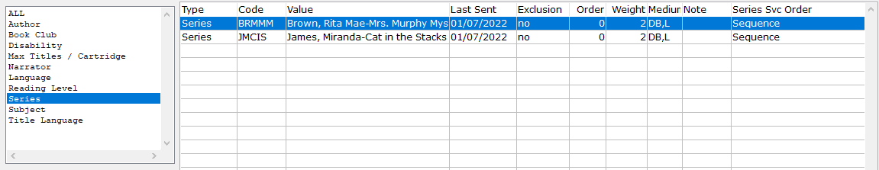
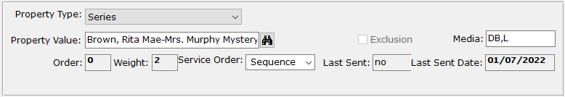
Patron - Series
“Round Robin” processing (for Duplication)
Select Pub Date or Sequence serve order

Slide 13
Reading History Opt-Out
Permanently anonymizes the patron’s HasHads, moving them to a “straw patron” record: DELPAT
  Anonymous record with same Library ID and Patron Type will be used for all Opt-Outs; created automatically if needed.
  You keep the stats, the patron gets their privacy.
  Remember that it will “break” Autoselect for that patron.
  Duplication Orders also moved / anonymized.

Slide 14
Front Desk
Contact Tab added
Duplication-related toolbars in Patron and Front Desk synced
Top toolbar and menu unresponsive; now corrected
Notes:
Front Desk Service manual available on KLASusers

Slide 15
Duplication
Queue Fill irregularities (not filling to max, inconsistent number of Series selections) corrected
HasHad check now starts the day after a title was added to the Service Queue
ReserveStatus updated appropriately when titles added to (or removed from) Service Queue

Slide 16
Duplication – Quality of Life “stuff”
Sequence field on Service Queue can now be directly updated
Success confirmations no longer display in Error windows

Slide 17
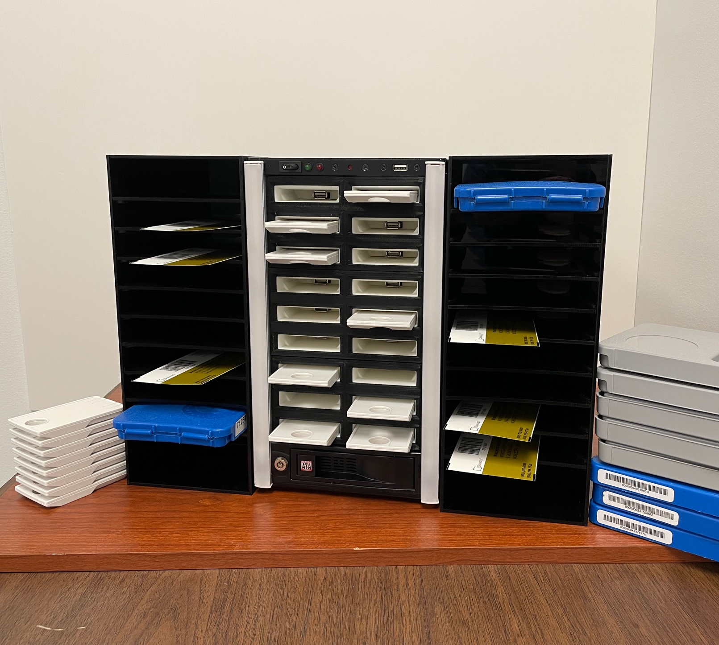
Duplication - Scribe
Audio cues available
Hardware ID removed from Web Monitor
NLS Cartridge unlocking coming ASAP
Scribe 2.0 hardware update
Notes:
Audio can be low verbosity (beeps) or high verbosity (messages); configured per Scribe

Slide 18
What’s Next?
OPAC Revamp!
Allow patrons to view Service Queue and Dup Orders
Patrons can edit Service Queue directly
Powerful (but easy) Advanced Search
Searchable Reading History
Option to request a whole Series
Notes:
Updated search options include profile search
Plus an updated look & feel, while keeping the focus on accessibility and ease of use

