Slide 1
2022 KLAS Users’ Group Business Meeting
May 4, 2022

Slide 2
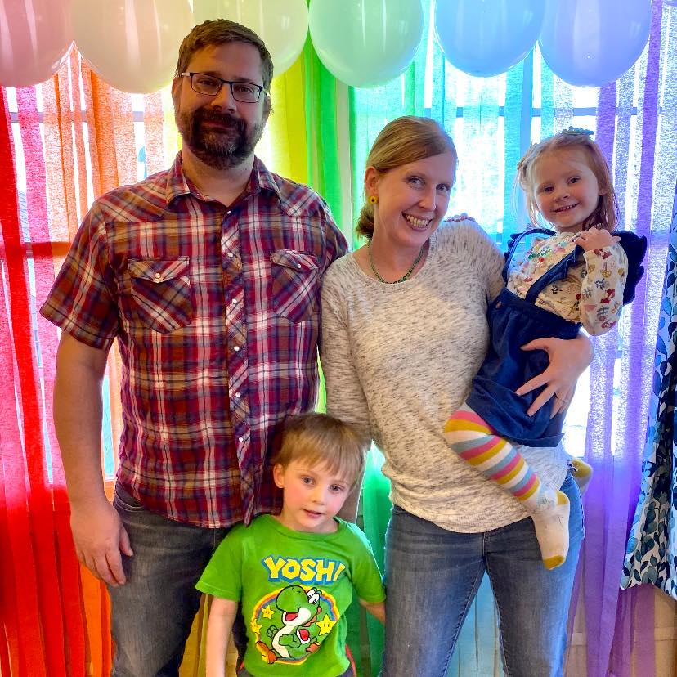
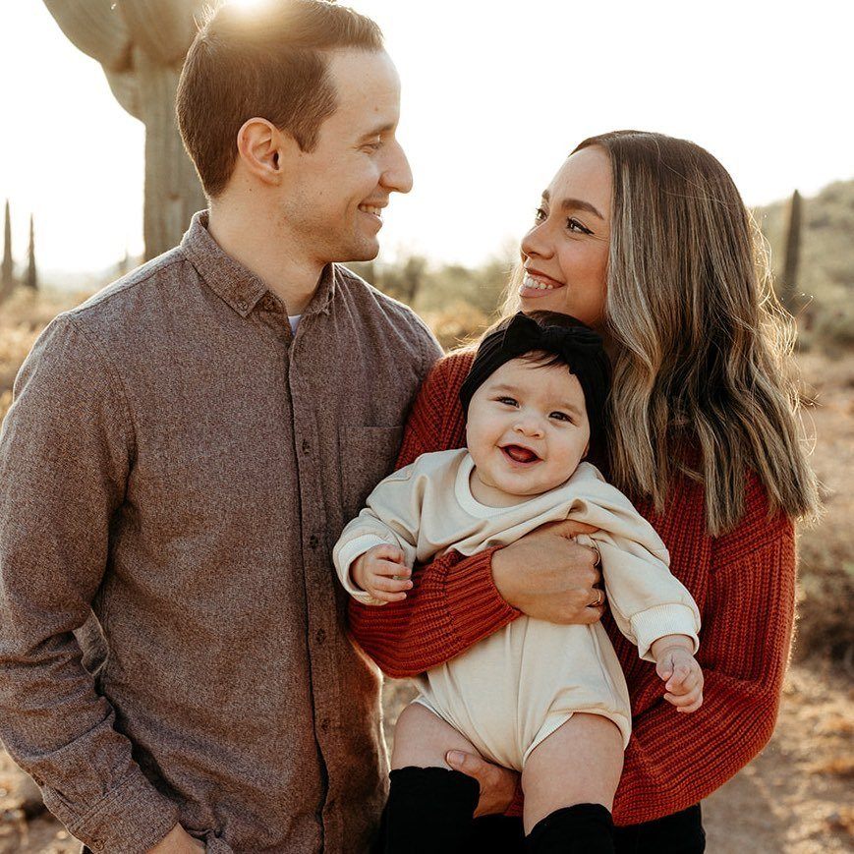
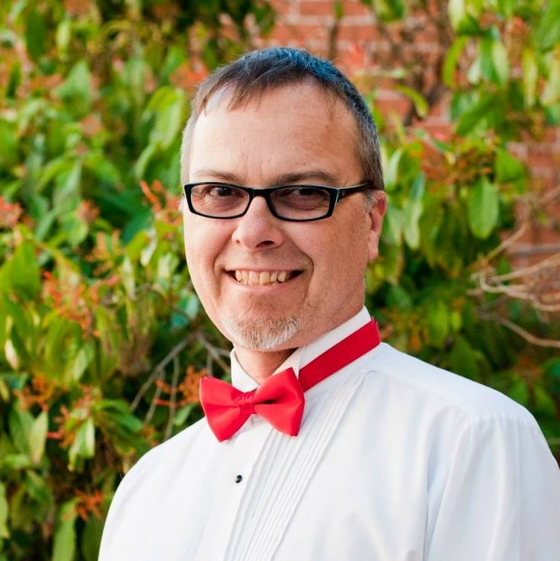

KLAS Users’ Officers
Michael Lang​
Jared Leslie​
Tony Bucci​
Vacant​
President
Vice-President
Secretary
Immediate Past-President

Slide 3
Agenda
Minutes
Committee Reports
  Program – Jared Leslie
  KLAS Development Advisory Committee (KDAC) – Sam Lundberg
  Logistics – Andrea Ewing Callicutt
Old Business
  Proposed bylaw changes
New Business
  Call for Vice-President nominees
Adjourn

Slide 4

Committee Reports

Slide 5

Old Business

Slide 6
Amendments to the Bylaws
Article X. Amendments to the Bylaws
Amendments of these bylaws will be considered at the Users’ Group Business Meeting. Proposed changes must be presented to all Users’ Group members at least fourteen days prior to the conference.
Further revisions will cease upon the adjournment of the conference and a final draft copy will be prepared and distributed within seven days. A two-thirds vote of the Users’ Group is required to adopt proposed Bylaws changes. Voting shall take place online within 30 days after draft changes have been posted.

Slide 7
Article VII. Committees
Current
The Conference Program Committee. Committee members should include at least one Officer, the local host, and other members who would like to serve on the committee. One person from an IRC and other agencies not from NLS libraries should serve on the committee when possible.
Proposed
The Users’ Group Program Committee. Committee members should include at least one Officer, local host representative during conference years, and other members who would like to serve on the committee. One person from an IRC and other agencies not from NLS libraries should serve on the committee when possible.

Slide 8
Article X. Amendments to the Bylaws
Current
Amendments of these bylaws will be considered at the Users’ Group Business Meeting. Proposed changes must be presented to all Users’ Group members at least fourteen days prior to the conference.
Further revisions will cease upon the adjournment of the conference and a final draft copy will be prepared and distributed within seven days. A two-thirds vote of the Users’ Group is required to adopt proposed Bylaws changes. Voting shall take place online within 30 days after draft changes have been posted.
Proposed
Amendments of these bylaws will be considered at the Users’ Group Business Meeting. Proposed changes must be presented to all Users’ Group members at least fourteen days prior to the business meeting.
Further revisions will cease upon the adjournment of the meeting and a final draft copy will be prepared and distributed within seven days. A two-thirds vote of the Users’ Group is required to adopt proposed Bylaws changes. Voting shall take place online within 30 days after draft changes are posted.

Slide 9

New Business

Slide 10
Vice-President Nominations
Article VI. Officers
Vice-President: The Vice-President shall serve in a mentoring and leadership capacity to learn about the responsibilities of the Users’ Group, and shall assist the President with designated duties. May be required to perform President’s duties if the President is unavailable. The Vice-President shall also serve on at least one committee outlined in Article VII.
The Vice-President assumes the office of President at the end of the term of the standing President in office.
The President, Vice President and Immediate Past-President will serve one-year terms each.

Slide 11
Officer Elections
If an election occurs in a nonconference year, it will be conducted online to facilitate broader participation of Users’ Group members.
Voting must be conducted and tabulated within 30 days.
A plurality of the votes is required to elect an officer.
The number of agencies voting will constitute a quorum.
Each agency member of the Users’ Group will receive one vote.
The terms for the new officers shall begin on August 1.

Slide 12
Adjourn
Thank you!

