Slide 1
NLS Regional 2023:
KLAS Users’ Meeting
May 18, 2023

Slide 2
Keystone Staff Presenters
Andrea Callicutt, Director Marketing, Sales & Communications
Mitake Holloman Burts, Chief Product Development Officer

Slide 3
Agenda
Keystone Updates & Current Customers
KLAS Users’ Community, Training & Events
Keystone Services
New KLAS LBPD Features
Upcoming Development
Questions & Discussion

Slide 4
Keystone Updates

Slide 5
Keystone Updates
Keystone staff back to office in a hybrid model
New Customer
  Minnesota State Services for the Blind

Slide 6

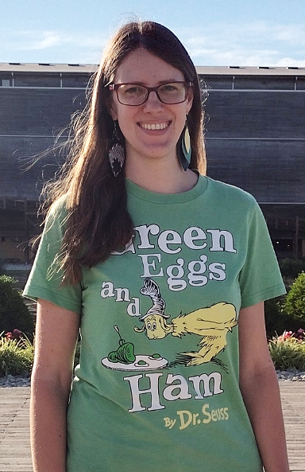
Keystone Updates
Hellos
  George Martell, Software Development
  Specialist
  Katharina Stevens, Customer
  Support Specialist

Slide 7
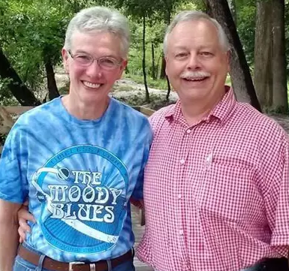

Keystone Updates
Goodbyes
  Brian White, Software Development, Project Lead - Retired April 2022
  John Owen, Customer Support Specialist - Retired December 2022

Slide 8
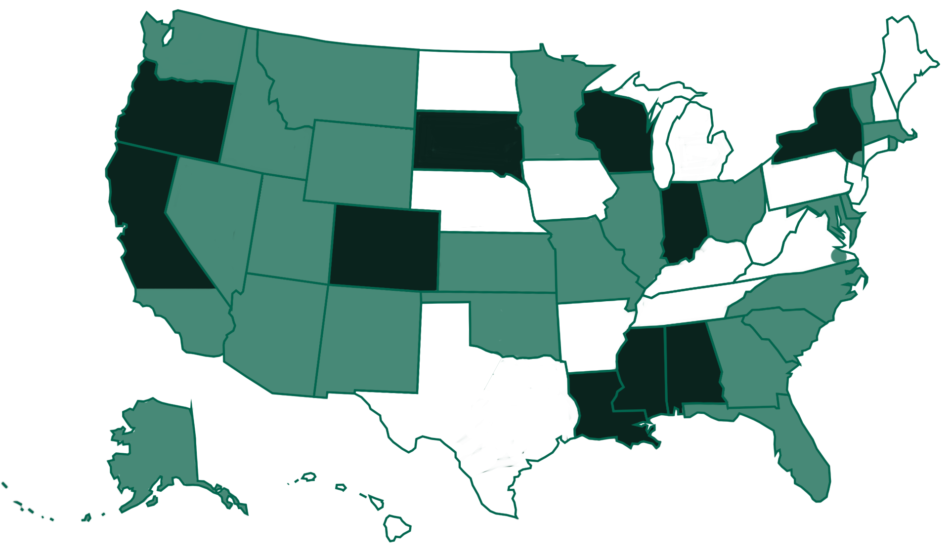
Current LBPD Customers
Notes:
Current LBPD KLAS Installations
Self-hosted: Alabama, northern California, Colorado, Indiana, Louisiana, Mississippi, New York state, Oregon, South Dakota, Wisconsin
Keystone Hosted: Alaska, Arizona, southern California (Braille Institute), Delaware, Florida, Georgia, Idaho, Illinois, Kansas, Maryland, Massachusetts, Minnesota, Missouri, Montana, Nevada, New Mexico, New York city, North Carolina, Ohio, Oklahoma, Rhode Island, South Carolina, Utah, Vermont, Virginia Beach, Washington, Wyoming

Slide 9
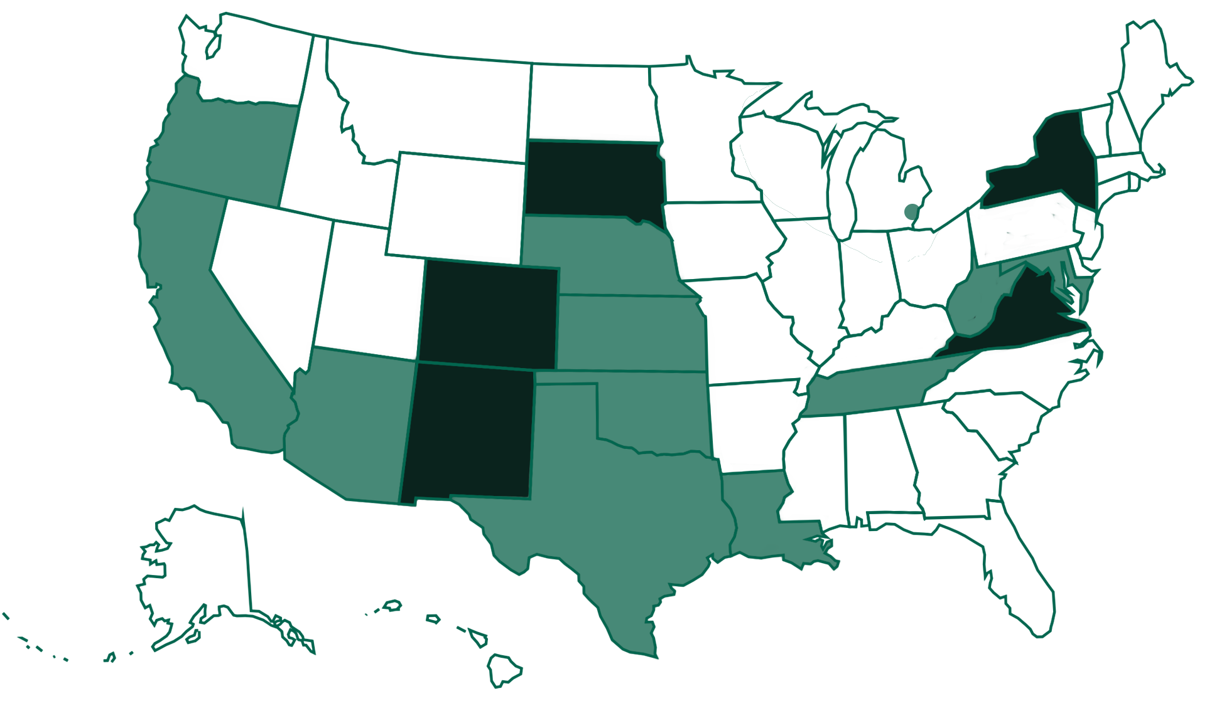
Current IRC / IMC Customers
Notes:
Current IRC KLAS Installations
Self-hosted: New York, Virginia, South Dakota, Colorado, New Mexico
Keystone Hosted: Maryland, West Virginia, Tennessee, Louisiana, Nebraska, Kansas, Oklahoma, Texas, Arizona, Oregon, California, Oakland County (MI)

Slide 10
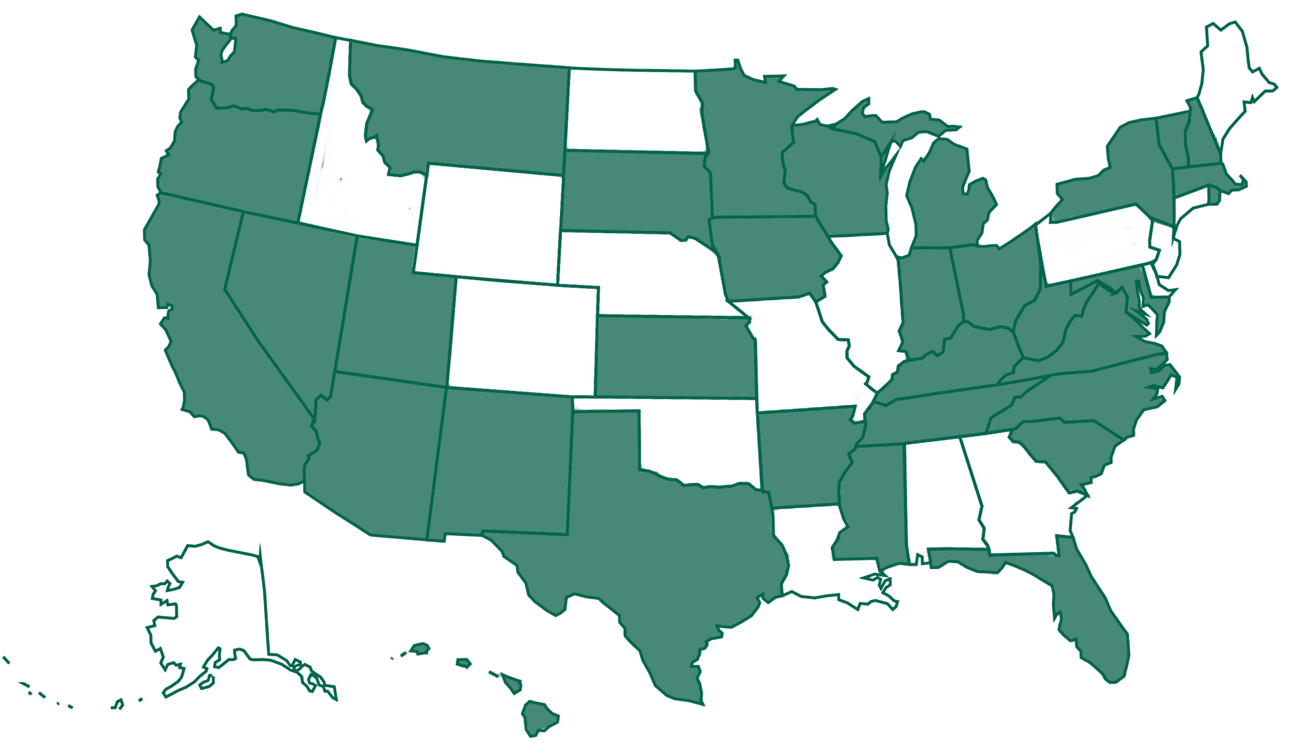
Current iCanConnect Customers
Notes:
KLAS / NDBEDP – National Deaf-Blind Equipment Distribution Program (iCanConnect) - A map with 32 states marked green to show that they use KLAS.

Slide 11
KLAS Users’ Community

Slide 12
KLAS Users’ Community
KLASUsers.com
  Knowledge Base
  Latest News
  Discussion Forum
  Tag list & search functionality to aid navigation
KLASUsers e-list
  Weekly Wrap-up

Slide 13
KLAS Users’ Training & Events
Keystone webinars
User-led webinars & roundtables
KLAS Users’ Conference
  KLAS UC 2023 - July 17-20, 2023 online & in-person at Tennessee School for the Blind in Nashville
Online KLAS Administrator Training

Slide 14
KLAS Users’ Group Officers
Traci Timmons, President, Washington Talking Book & Braille Library
Maureen Dorosinski, Vice President, Florida Bureau of Braille & Talking Book Library Services
Tony Bucci, Secretary, Arizona Talking Book Library
Michael Lang, Immediate Past President, Kansas Talking Books Service

Slide 15
KLAS Users’ Group Committees
KLAS Users’ Program Committee
  Chair: Kate Kosior, South Dakota Braille & Talking Book Library
KLAS Users’ Logistics Committee
  Chair: Sarah Smedley, Palm Beach County Library Talking Books
KLAS Development Advisory Committee (KDAC)
  Chair: Dan Malosh, Minnesota Braille & Talking Book Library

Slide 16
KDAC
KLAS Development Advisory Committee
Serves an advisory role to Keystone on new features being developed for future releases of KLAS.
Meets 1x/month
Representatives from LBPD, IRC, & Organization / School Libraries
2021 & 2022 Surveys

Slide 17
KDAC LBPD Members
Dan Malosh, Chair, Minnesota Braille & Talking Book Library
Sarah Smedley, Palm Beach County Library Talking Books
Traci Timmons, Officers’ Liaison, Washington Talking Book & Braille Library
Zoleinna Schar, Nevada Talking Book Services
Jesse McGarity, Bayside Area & Special Services Library at the Virginia Beach Public Library
Barnaby Camp, Georgia Library Service for the Blind and Print Disabled

Slide 18
Keystone Services

Slide 19

Database Hosting
Beginning in February 2020, Keystone’s database hosting moved to Amazon AWS servers.
How does this benefit your organization?
  Multiple zones across the US (in VA, OH, CA, OR)
  Amazon security practices, plus our own
  Encryption of file storage
  IT groups are often more
  comfortable with AWS
This Photo by Unknown Author is licensed under CC BY-SA
Notes:
Since KLAS UC 2021 – for preview updates, please review the conference New Features presentation: https://klasusers.com/knowledge-base/2021-klas-users-conference-presentations-handouts

Slide 20
Database Hosting
  Database Backups
    Backups stored in multiple AWS zones
    Encrypted Backups also stored outside of AWS, on Google
  System restore
    Scripted automated restore of systems
      Previously, restoring a system took hours
      All customers can be restored in less than 30 minutes

Slide 21

SSAE Audit
SSAE Audit = an independent review of our IT procedures to ensure we’re meeting security standards
Successfully completed 2022 audit
  Audit report available for your IT group to review

Slide 22
New KLAS
LBPD Features

Slide 23
New KLAS LBPD Features
Duplication – Scribe
Unlocking of NLS cartridges (new & repurposed)
Filter Mail Cards by Medium
Cartridge Volume Label set as required for Zoomax braille readers
Additional logging and monitoring

Slide 24
New KLAS LBPD Features
Patron
Multiple records with the same Patron ID can be deleted
Catalog
Support for Relator terms on Headings
Various bug fixes

Slide 25
New KLAS LBPD Features
WebOPAC
Popular Titles browse lists now count Duplications
Fix for inconsistency in Rush Reserves being pushed to Service Queues

Slide 26
New KLAS LBPD Features
KLAS 7.8
Runs on OpenEdge 12
Windows 11 22H2 support
Back-compatible with earlier versions of Windows
Server updates
Framework update, not feature update

Slide 27
Upcoming Development

Slide 28
Upcoming Development
Scribe Updates
New WebMonitor
Much improved collection of statistics
New (still invisible) Operating System
Notes:
Stats examples: min/avg, max orders by scribe unit, orders by lib all based on time frame specified, failure rates, cache efficiency, min/avg/max file size, qty of files, a bunch more, duplication times and volumes

Slide 29
Upcoming Development (cont’d)
New WebOPAC
Development resumed; timeline forthcoming
DOD Improvements
Working with NLS to provide remote duplication
  Allow for Multi-State Centers to provide duplication in the case of an emergency
  Expect to have more to say at KLAS Users’ Conference

Slide 30
Questions to consider
Cataloging service
With the increasing number of titles being added to the collection, we have been approached by some libraries about potentially helping provide additional services to help with the cataloging effort.

Slide 31
Cataloging Service (cont’d)
Currently considering the Cataloging Service to help maintain:
    Consistency of Subjects and Series data loaded from NLS
    Double-check Primary cataloging data
    Series information
    Double-check original publisher and pub date, Alt format publisher and Alt format pub date
    Double-check Narrator and Length information
    Apply Long Book/Short Book designation
    Load in RUB ratings
Cost?
Depends on the number of libraries that want to take advantage of this. Targeting $200-$250/month with good adoption by libraries.

