Slide 1


APH 2023: KLAS IRC / IMC
Users’ Group Meeting
October 3, 2023

Slide 2
Keystone Staff Presenters
Andrea Ewing Callicutt, Director of Marketing, Sales & Communications
Marion Campbell, Customer Support Specialist
Kyle Honeycutt, Manager of Software Development

Slide 3
Agenda
Keystone Updates & Current Customers
KLAS Users’ - Community, Training, & Events
Keystone Services
New KLAS IRC Features
Upcoming Development
Questions & Discussion

Slide 4


Keystone Updates
In case you hadn’t heard:
Brian White retired in March ’22
George Martell joined Keystone
May ’22

Slide 5


Keystone Updates cont.
In case you hadn’t heard:
John Owen retired December ’22
Katharina Stevens joined July ’22

Slide 6
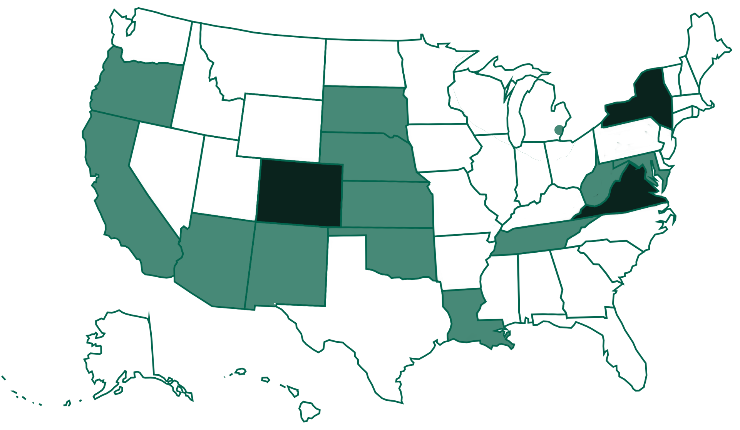
Current IRC / IMC Customers
Notes:
Self-hosted: New York, Virginia, and Colorado
Keystone-hosted: Delaware, West Virginia, Tennessee, Louisiana, South Dakota, Nebraska, Kansas, Oklahoma, New Mexico, Arizona, Oregon, and California

Slide 7
KLAS Users’
KLASusers.com
KLAS IRC / IMC User Listserv: klasusers-irc@lists.klas.com
Program Committee
IRC reps needed!
KLAS IRC Admin Training
When should we do the next session?
2024 KLAS Mini-Conference
Where: Online
When: May 7-8
2025 KLAS Users’ Conference
Where: Indianapolis, IN
When: TBD

Slide 8

Keystone Services Updates
Beginning in 2020, Keystone’s database hosting moved to Amazon AWS servers.
How does this benefit your organization?
  Multiple zones across the US (in VA, OH, CA, OR)
  Amazon security practices, plus our own
  Encryption of file storage
  IT groups are often more
  comfortable with AWS

Slide 9
Hosting – AWS Benefits
Database Hosting -- Backups
  Backups stored in multiple AWS zones
  Encrypted Backups also stored on Google
System restore
  Scripted automated restore of systems
    Previously, restoring a system took hours
    All customers can be restored in less than 30 minutes

Slide 10

SSAE Audit
SSAE Audit = an independent review of our IT procedures to ensure we’re meeting security standards
Successfully completed 2023 audit;
report available for your IT group to
review

Slide 11
APH Ordering Integration
Production testing of sending orders for materials directly to APH’s computer system.
  Beta test revealed additional work needed on both sides of integration

Slide 12
New KLAS IRC Features:
KLAS Core Functionality
Cataloging & Acquisitions
Materials Requests, WebOrder & Patron
APH Integration
& more…
Notes:
Presenter tips: This layout is great for large screenshots – but you can also remove the heading placeholder from any slide to make the content larger. The world is your oyster!

Slide 13
KLAS Core
Windows 11 Support!
KLAS v7.8
Back-compatible to Windows 10
Framework update to OpenEdge 12
Server updates for Keystone-hosted databases
Notes:
https://klasusers.com/klas-news/regression-testing-you

Slide 14
Catalog
New Fields on the Items tab to allow more part-specific info.
  ItemType (ex. vol, prelim, sup; read-only)
  ItemEnum (ex. 1, 2, 3, etc.)
  VolumeExtent (quantity of units in the item)
  ExtentUnits (unit for the VolumeExtent quantity, ex. Pages)
  PubNote
  NonPublicNote.
Notes:
The full Item Enumeration will now be calculated based on the ItemType+Enum (Supplement 1 would be "S 1" and Volume 2 would be "2“).
New fields allow you to track number of braille pages, or otherwise record the extent of the item, record notes, and better control the enumeration.

Slide 15
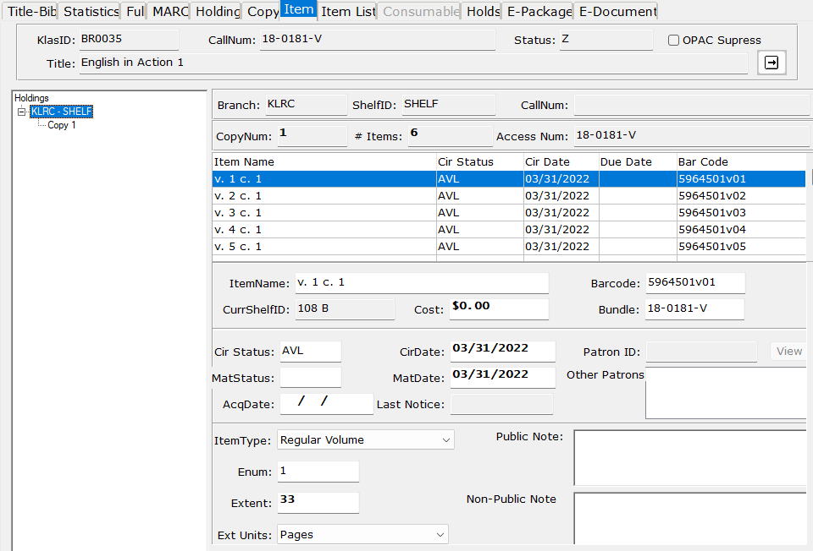
Catalog screenshot

Slide 16
Material Requests
Setting added for whether the tax for a PO is set on the Header or by Line
MatRequest Line tab can now record up to four lines of Sub-Detail
  Extended price calculated automatically (quantity*unit price)
Notes:
7.7.75 #KLAS-2905, 2853
7.8.2 #KLAS-2975
Extended price does not automatically update the unit price of the parent MatRequest Line at this time.
Number of sub-detail lines and defaults configured by Line Type.

Slide 17
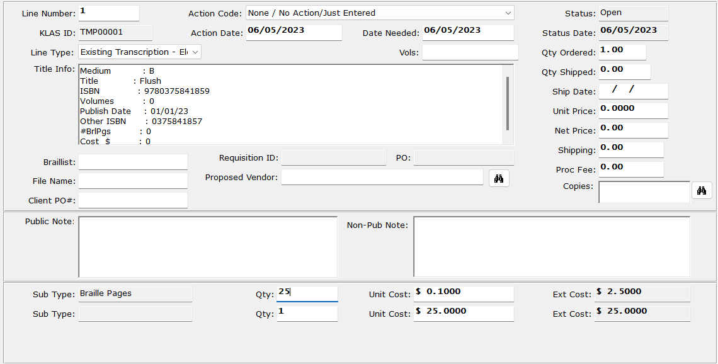
Material Requests screenshot

Slide 18
Acquisitions
Invoice ID expanded from 8 characters to 15
Invoice Line tab header now displays Patron ID and Name
Notes:
Invoice ID: 7.8.2 #KLAS-2985
Line Sub-detail: 7.8.3 #KLAS-3004
Line header: 7.8.4 #KLAS-3009

Slide 19
Acquisitions - New Invoice Print Tokens
Header Form
Detail Form
CurrentPage
InvoicePatronID & Name
Resp1-2 and Child1-2 PatronID & Name
ChildPatronID & Name
ShipToAttention
MRUserRef1-2
MRLineUserRef1 to 3
Trim(@Token@)
LineNum
InvoiceLineType & Desc
PubYear
NumVolumes
MRUserRef1-2
MRLineUserRef1 to 3
Notes:
Note that, for fields stored on the MatRequest, the Invoice print output will look to the MatRequest associated with the first Line of the Invoice.
7.8.4 #KALS-2995

Slide 20
Patron
Patron Census Notice option to generate output as multiple files fixed
Notes:
Census notice fix: 7.7.74 #KLAS-2869

Slide 21
WebOrder
Fixed WebOrder download links
Fixed recent bugs blocking Add MatRequest or using 2-level
Circulation pattern
Notes:
Download links: 7.7.71 #KLAS-2855
Bugs: 7.8.3 #KLAS-3013
7.8.4 #KLAS-3014
7.8.4 #KLAS-2955

Slide 22
APH Census
Additional configurable values for PatronTypes, relationships
Now supports certifiers responsible more than 1 district
Certify runs faster for re-submits
Fixes for irrelevant errors on WebOrder Census
More flexibility
Bug fixes
Notes:
Configuration: 7.7.77 #KLAS-2928
Certifiers for more than 1 district and faster re-submits: 7.8.2 #KLAS-2964
Irrelevant error: 7.8.2 #KLAS-2965 Disability and handicap code validation errors fixed; “invalid IEP” for IRCs that do not include IEP on Web coming soon

Slide 23
APH Integration
Set up in KLAS
needed to connect Vendor to online ordering URL & embed your credentials.
Then, just use the “Set as On Order” button
It’s (almost) here!
  APH online ordering is now Live at our Beta customer!
Notes:
Set as On Order: 7.8.2 #KLAS-2984
Check order status: 7.8.2 #KLAS-2994

Slide 24
Upcoming Development:
APH Census updates
Tracking numbers
APH Catalog Integration
& more…
Notes:
Presenter tips: This layout is great for large screenshots – but you can also remove the heading placeholder from any slide to make the content larger. The world is your oyster!

Slide 25
APH Census Updates
  Any changes mandated by APH (new fields, etc.)
  Get local procedures (including the export) integrated into KLAS baseline
  New screens to run export and other features
  Possible - way for teachers to return the completed pdf (Digitizing Documentation)
  Possible - updates to Census Notice
Notes:
Return Completed Census Notice – Do we need to provide a way for teachers to securely upload completed Census Notice pdfs? Potentially upload via WebOrder? Note: email is not secure!
Census Notice – Does this need to be an editable PDF?

Slide 26
Upcoming Development
Tool to remove Graduated/Withdrawn student info from database
New Tracked Shipment Function
  USPS free matter, other tracking APIs (Ex: FedEx, UPS, etc.)

Slide 27
New Feature Suggestions from klasusers.com discussion forums & enhancement requests:
Making a patron “Not Active” automatically makes their relationships “Inactive”
Add a “Go to PO” from Mat Requests - Line Details Tab
Add a “Go to Catalog Record” from Mat Requests – Line Details Tab
Add “Go to Patron Record” from Mat Request for All Patrons

Slide 28
New Feature Suggestions from klasusers.com discussion forums & enhancement requests:
Make the “On Order” counter functional in Equipment & Catalog
Add tab to show “Open Purchase Orders” in Equipment & Catalog
Add tab to show “Open Mat Requests” in Equipment & Catalog

Slide 29
Q&A

