Slide 1
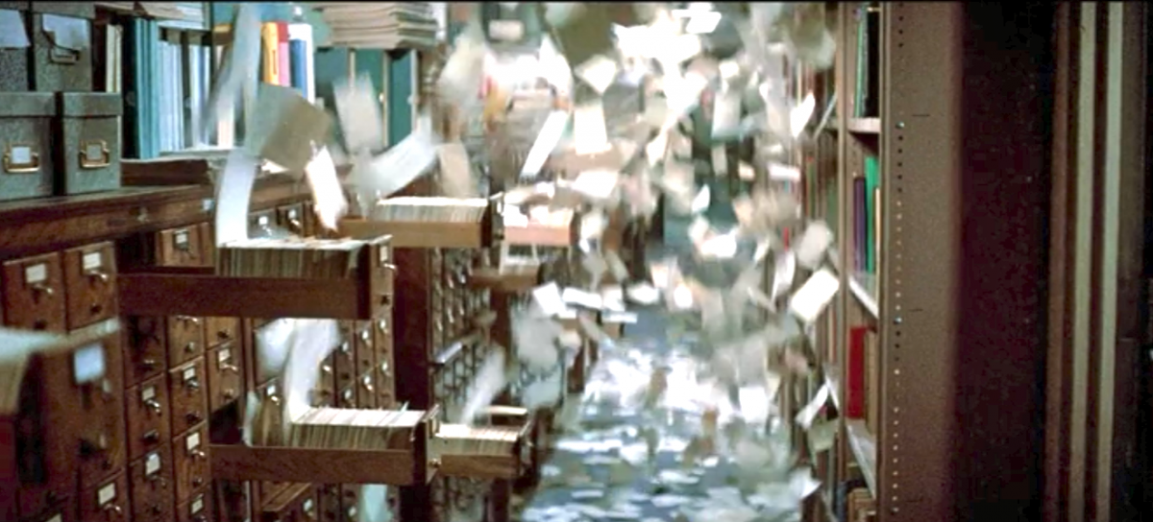
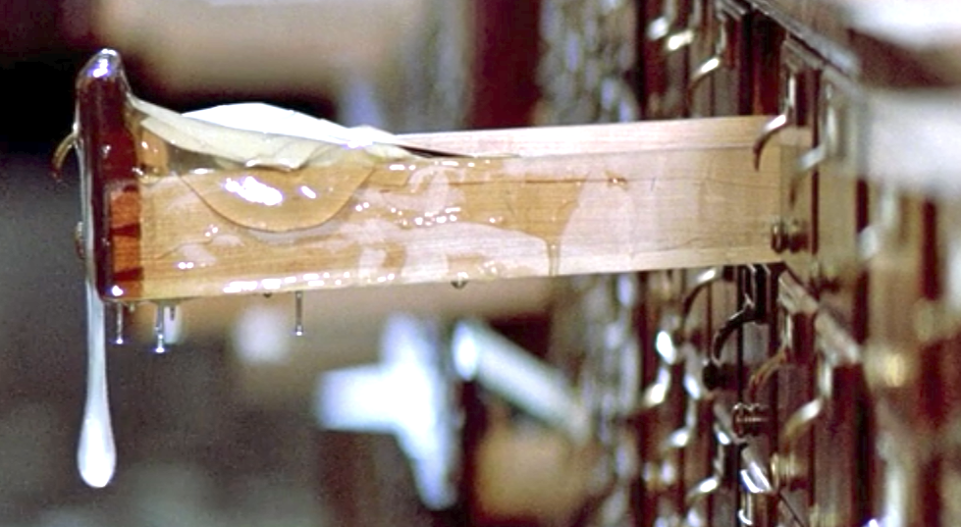

Cleaning Up The
Catalog
Meghan McCormack –
Wolfner Talking Book and Braille Library

Slide 2

Cleaning Up the Catalog
No catalog is perfect, but with KLAS and Excel…we can find a number of problems quickly. (Some are easily fixed. Others—not so much.)
CAVEAT: Many searches can be done to find materials specifically…generally: broad will
get you everything, but can
be tens of thousands of items

Slide 3

What types of errors have been located
(or mentioned by patrons and investigated)
Series Errors
  Wrong Sequence.
  Multiple copies of the same title
Missing Exclusion codes – Sexual content, strong language, violence.
Length; JUV, YA, and Adult Book
General Subject Codes – Something more specific is present, but the overarching code is missing. (e.g. Biography, Historical but Biography is not there)
Incorrect Grade codes
Fiction and Nonfiction Checkbox

Slide 4
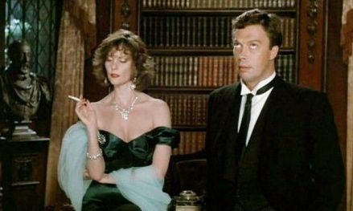
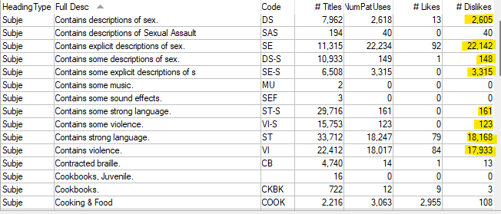
Where We Started
Exclusion Codes:
  Violence, Descriptions of Sex, Explicit Descriptions of Sex, and Strong Language
We knew a significant portion of the back catalog was missing these codes (and more).
Exclusion codes was the first major issue that we wanted to address.
Opting in to KLAS subject code mapping gave us more exclusion codes than we previously used. This has been corrected (not difficult, but had to be switched on thousands of titles).

Slide 5
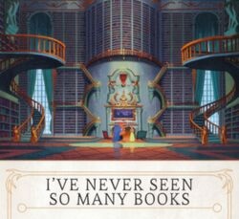
How to Find the Books?
The QUERY…
Advanced Search
BibRec -> Annotations -> matches -> descriptions of sex
This finds all materials within the collection with “Descriptions of sex” in the annotation. (almost 34,000 items for Wolfner.)
Best refine this one a little.
BibRec -> Annotations -> matches -> descriptions of sex
BibRec -> Title Status -> begins -> A
23,941 – Better
Find which books need the codes:
Export them to Excel.
Custom filter” Does not contain “descriptions of sex” in the subjects.
Copy and paste the filtered results into a new tab.
Filter Annotation for contains “explicit descriptions.”
Copy and paste results into a new sheet.
Filter annotation for contains “some explicit”
Copy and paste the KLAS IDs into notepad
Import into KLAS and select to go into the query
Add the code
Change filter to be “does not contain” and apply. Repeat 7-9 and add the code.

Slide 6
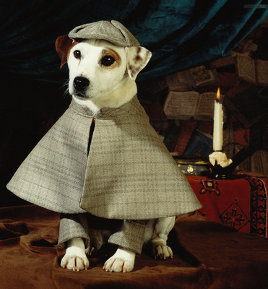
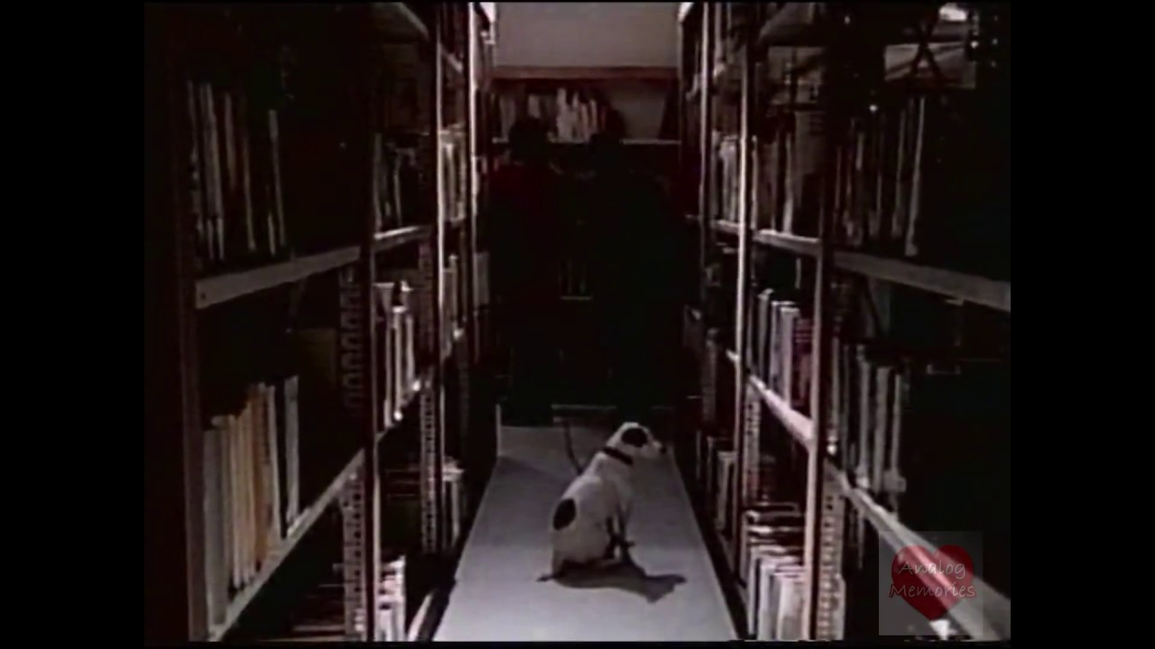
How Many were Updated?
1,307 books in Wolfner’s Collection were missing
an exclusion code for one of the sex codes:
  907 – DS-S, Some Descriptions of sex
  257 – DS, Descriptions of sex
  11 – SE, Explicit descriptions of sex
  24 – SE-S, Some explicit descriptions of sex
8,269 titles moved from “Contains” to “contains some” just with our sex code changes. This opened up these books to thousands who are served via nightly autoselect.
To find the other exclusion codes, repeat the steps, searching the annotation for matches strong language and matches “violence” separately.
CAVEAT – Violence gets books that do not have the exclusion but the word is used in the annotation. i.e. There are many books (around 500 had to be individually checked to see if Violence should be applied)
Update Headings-Query set is a wonderful, wonderful tool!

Slide 7

Fun Ways of Saying that a book has…content
Books with typos such as “Decsriptions of sex”…I’ve consistently corrected this one as I found it.
I’ve also encountered:
  “Some sex.” - 61
  “Includes sex.” – 10
  “Explicit sex.” - 21
  “Sex,/Sex.” – Careful—This one finds books that don’t need codes added such as those with text – “Essex, England.” (Not a large number)
  “Contains no explicit descriptions of sex” – DB019905 and DB016732, DB016073
  “No descriptions of sex” – DB097501
  “Explict descriptions of sex.”
  “Description of sex.” – Several variations on this one (this found them all…)
  Contains scenes with sex and violence.
(The RUB rating books spreadsheet shares similarities in the way this content is listed.)
DBGs were all coming in as “Unrated” when we first began getting them, but many had exclusion codes listed in the annotations.
By the way…sometimes, Strong language is conveyed with the word…Profanity.

Slide 8
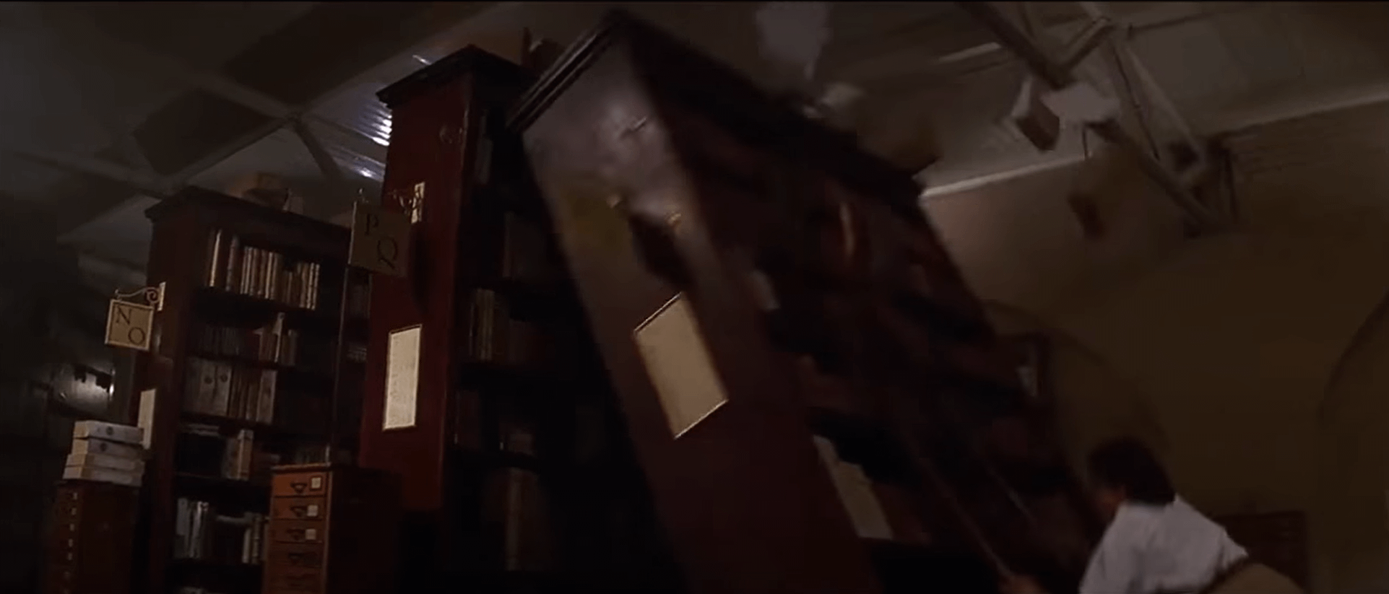
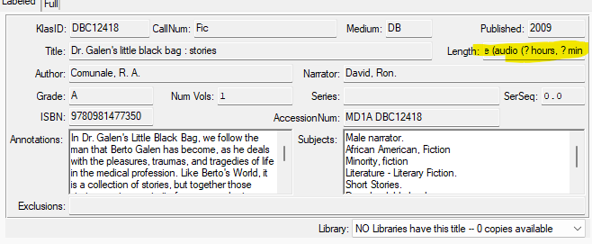
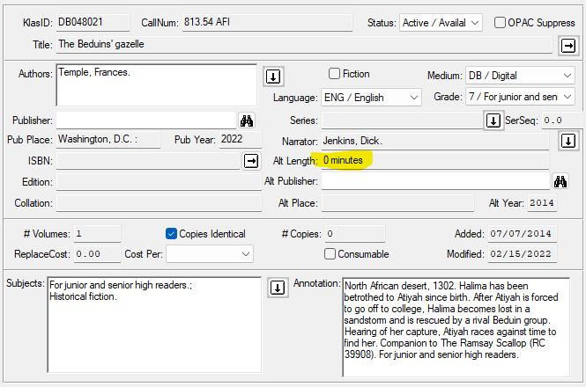
Strange Lengths?
Lots of mistakes on the record below….
Uncommon; but searchable.
Query: Advanced Search
MARC->Tag->Begins->306
MARC->Subfield->begins->a
MARC->Data->equals->000000
5 results (This query will return…fancier later on.)

Slide 9
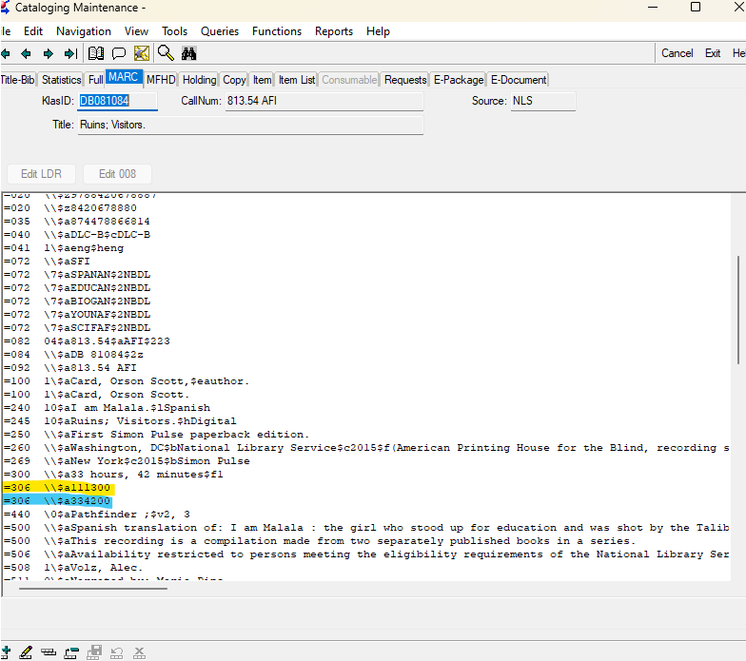
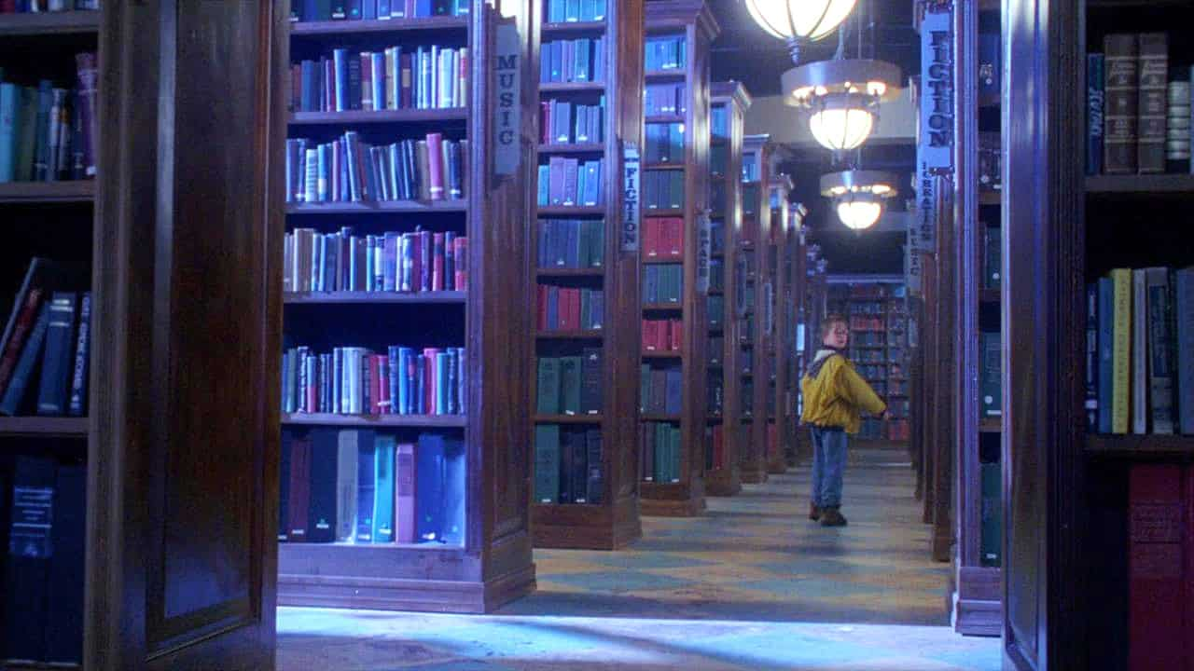
Length Codes (more)
Using the 306 MARC tag data is generally an excellent way of finding all books of a certain length.
Rarely the MARC Tag is wrong…but the alt length has been corrected by a cataloger.
Sorting by length code in Excel will make finding books that a code should not be applied to much more easily.

Slide 10
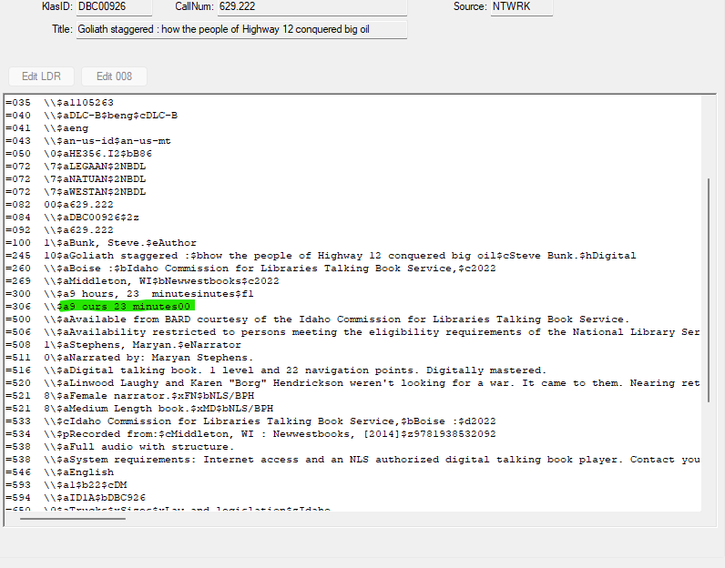
What the 306 can look like
QUERY THAT FOUND THIS
MARC Tag -> Tag -> Begins -> 306
MARC Tag -> Subfield -> begins -> a
MARC Tag -> Data -> is between ->
240000 and 9999999
(24 hours, 0 minutes and high
number)
BibRec -> Title Status -> begins -> A
This query should return only Very Long digital books. (Less than 6,000 titles)

Slide 11
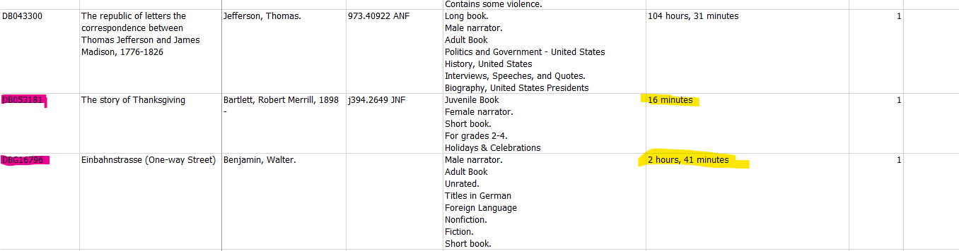
Wrong MARC Tag
I’ve yet to find a field in Excel that can’t be used to double check what I am trying to find and correct. In this case, sort alt length, A to Z. Yes, there are thousands of records, but a removing records that already have “Very long book” applied narrows results, and a quick scan can usually show the oddities and prevent codes from being applied in error.

Slide 12
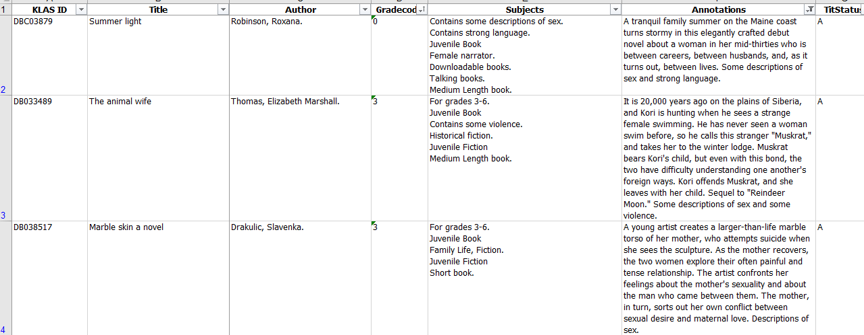
GRADE CODE INCORRECT
This one has multiple ways to think about and search for what needs changing

Slide 13
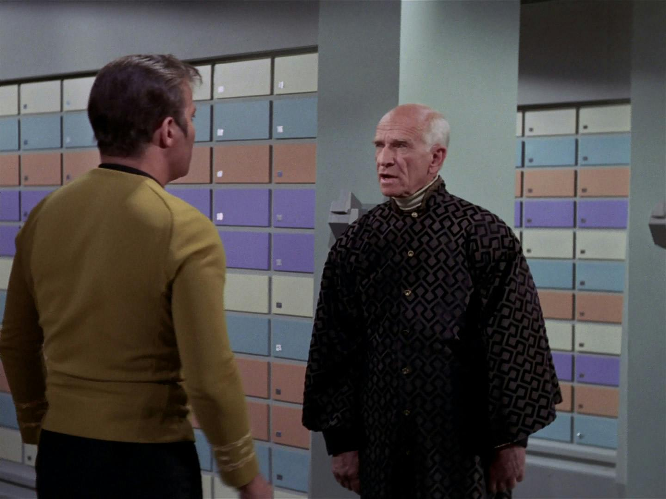
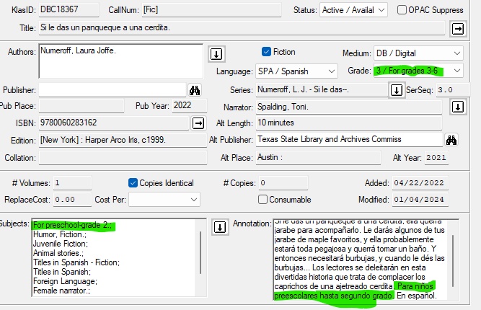
Grade Code Anomalies
Subjects and annotations match, but the Grade code is wrong, so it likely won’t circulate to children most interested in it.
You can query looking for grades that are mismatched with subject codes.

Slide 14
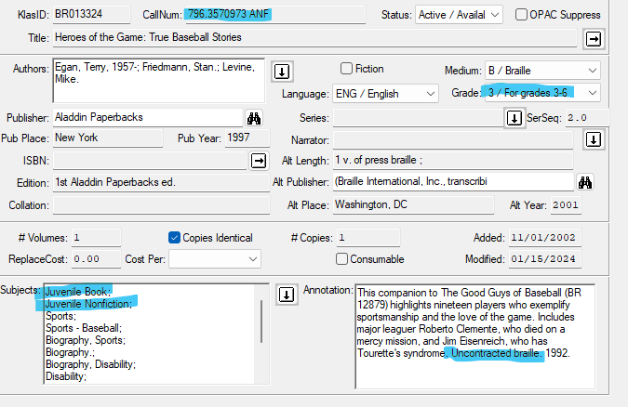
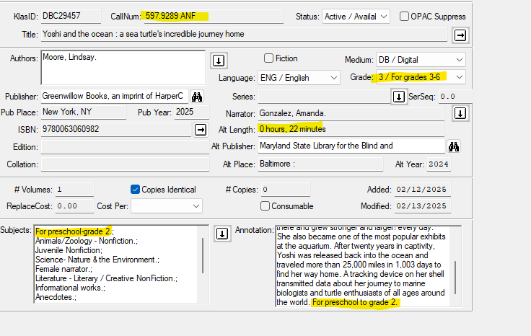
Call Numbers…They’re great., except when they’re wrong. Always double check with TomCat.

Slide 15
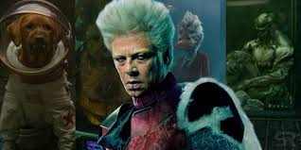
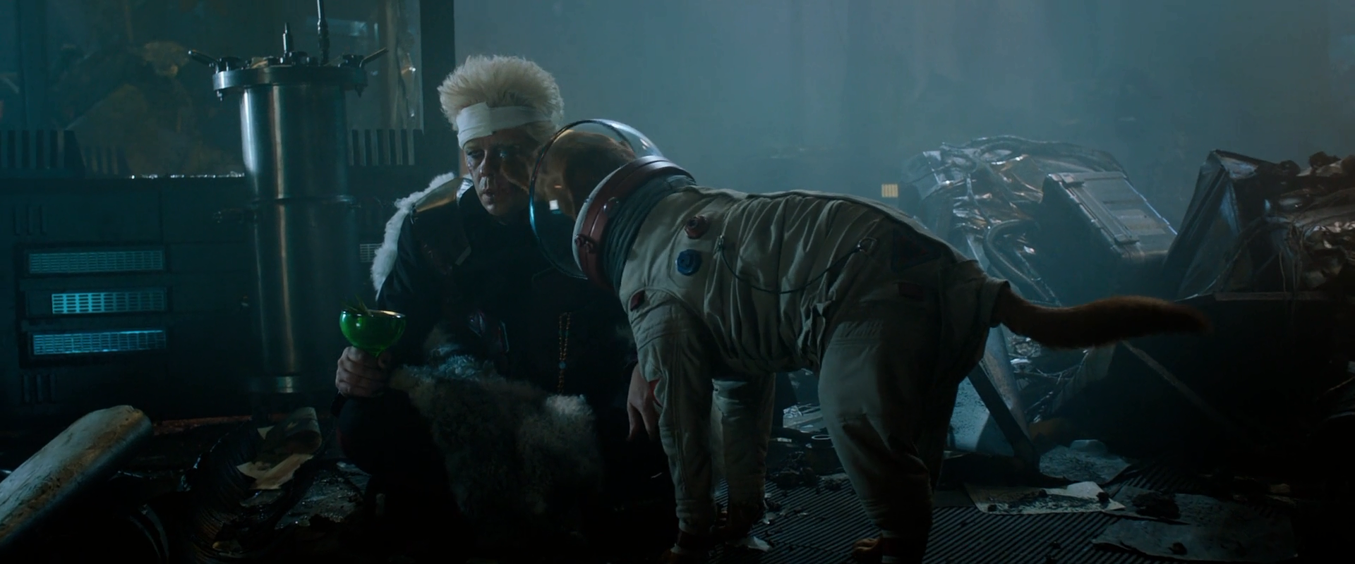
Fun Facts
Subject codes are written over by KLAS if a record is reloaded.
So some work can slowly be lost. Keeping an eye on the reuploaded and the records with the NEW Cataloging source code.
With great power comes with great potential for messing up…double check everything.
Or this happens to
your collection… →
(You don’t want that)

Slide 16

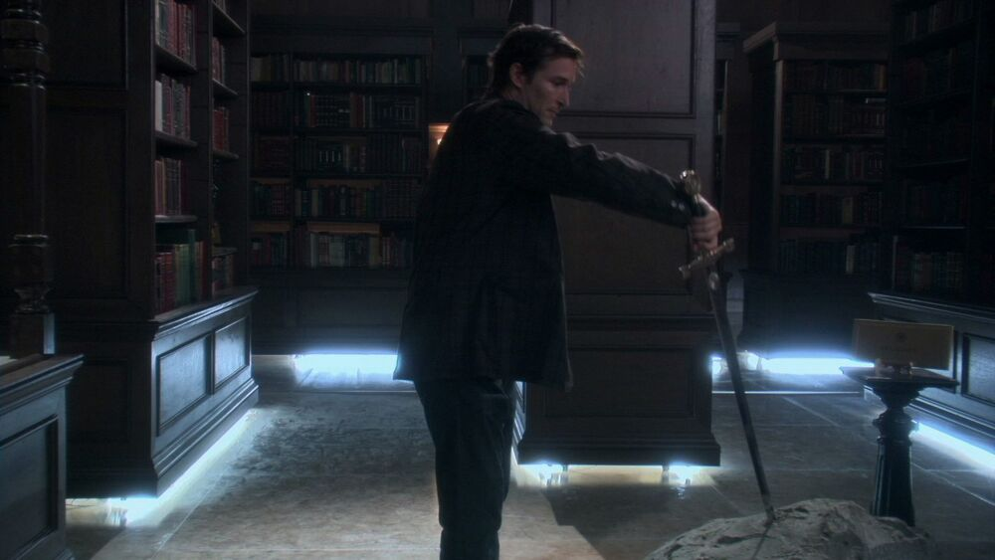

Slide 17
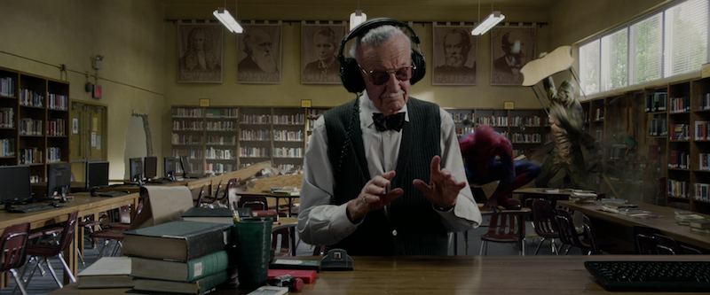
Questions & Answers

